Slide 1
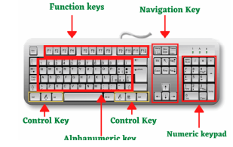
KEYBOARD
A keyboard is a peripheral device that enables a user to input text into a computer or any other electronic machinery. It is a peripheral device that is the most basic way for the user to communicate with a computer. It consists of multiple buttons, which create numbers, symbols, and letters, and special keys like the Windows and Alt key, including performing other functions.

Slide 2
TYPE OF KEY'S
Alphabet Keys
Numeric Keys
Function Keys
Space Bar
Shift Key
Enter Key
Backspace Key
Arrow Keys

Slide 3
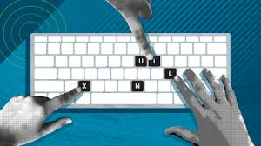
Uses of Keyboard in Computer
Input Date
Type Numbers
Text Chatting
Type Special Character
Types computer short cut Keys

Slide 4

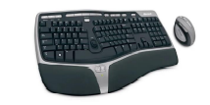

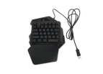
TYPE OF KEYBOARD'S
Gaming Keyboard
Ergonomic Keyboard
Multimedia Keyboard
Hand Keyboard
Flexible Keyboards
Unique Features
Wireless Keyboard
Laser Virtual Keyboards

